Slide 1
Physical Transmission

Slide 2
Transmission Basics
Transmission techniques in use on today’s network are complex and varied
This section covers:
Measurements that indicate network efficiency
Obstacles to good network performance

Slide 3
Frequency, Bandwidth, and Throughput
Frequency is typically measured in MHz or GHz, which indicates the number of times in a second that an electrical signal can change states
Bandwidth is the amount of data that could be theoretically transmitted during a given period of time
Throughput is the measure of how much data is actually transmitted during given time period
New technologies such as modulation (sending data over an analogue signal) and encoding (converting data into a digital signal for transmission) offer methods for increasing theoretical bandwidth and effective data throughput given the same maximum frequency

Slide 4
Transmission Flaws (1 of 2)
Noise is any undesirable influence degrading or distorting signal
Noise is measured in dB (decibels)
Two common sources of noise include the following:
EMI (electromagnetic interference) is caused by motors, power lines, televisions, copiers, fluorescent lights, etc…
One type of EMI is RFI (radio frequency interference)
Cross-talk occurs when the signal on one wire infringes on adjacent wire signal
Alien cross-talk occurs between two cables
Near end cross-talk (NEXT) occurs near source
Far end cross-talk (FEXT) occurs at the far end

Slide 5
Transmission Flaws (2 of 2)
Attenuation is the loss of a signal’s strength as it travels away from source
Signals can be boosted using a repeater, which regenerates a digital signal in its original form without noise previously accumulated
Latency is the delay between signal transmission and receipt
Latency may cause network transmission errors
The length of the cable affects latency, as does the existence of any intervening device

Slide 6
Transmission Flaws (2 of 2)
RTT (round trip time) is the time for packet to go from sender to receiver, then back from receiver to sender
If packets experience varying amounts of delay they can arrive out of order
A problem commonly called jitter or PDV (packet delay variation)

Slide 7
Duplex, Half-Duplex, and Simplex (1 of 2)
NIC settings include the direction in which signals travel over the media and the number of signals that can traverse the media at any given time
These two settings are combined to create different methods of communication
Full-duplex – Signals travel in both directions over a medium simultaneously
Half-duplex – Signals may travel in both directions but only in one direction at a time
Simplex – Signals may travel in only one direction and is sometimes called one-way or unidirectional, communication
In Windows, use Device Manager to configure a NIC, including speed and duplex settings

Slide 8
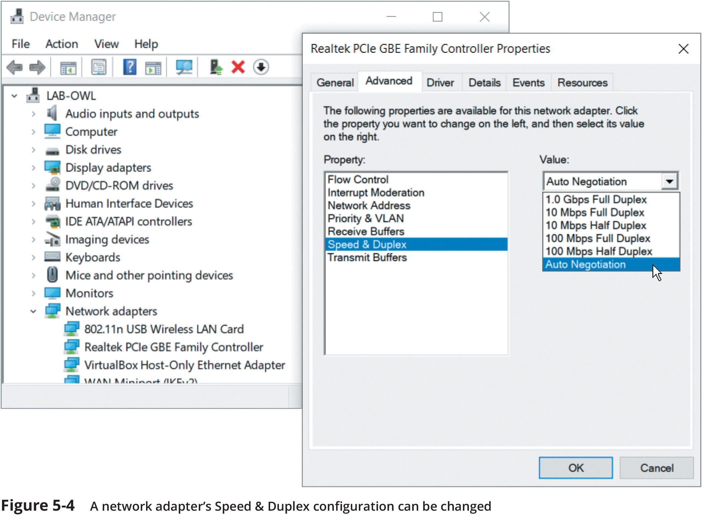
Duplex, Half-Duplex, and Simplex (2 of 2)

Slide 9
Multiplexing (1 of 2)
Multiplexing is a form of transmission that allows multiple signals to travel simultaneously over one medium
To carry multiple signals, the medium’s channel is logically separated into multiple smaller channels, or subchannels
Multiplexer (mux) is a device that combines many channel signals
It is required at the transmitting end of the channel

Slide 10
Multiplexing (1 of 2)
A demultiplexer (demux) separates the combined signals on the receiving end
Three types of multiplexing are used on copper lines:
TDM (Time division multiplexing) divides a channel into multiple time intervals
STDM (statistical time division multiplexing) assigns slots to nodes according to priority and need
FDM (Frequency Division Multiplexing) assigns different frequency band for each communications subchannel

Slide 11
Multiplexing (2 of 2)
Three types of multiplexing are used on fiber-optic cable
WDM (Wavelength Division Multiplexing) carries multiple light signals simultaneously by dividing a light beam into different wavelengths or colors
DWDM (Dense Wavelength Division Multiplexing) increases the number of channels provided by normal WDM
CWDM (Coarse Wavelength Division Multiplexing) lowers cost by spacing frequency bands wider apart to allow for cheaper transceiver equipment

